Slide 1

POKEDEX
MISAEL BOLAINEZ - LAB 2L
ROHIT VEMURI - LAB 3L

Slide 2
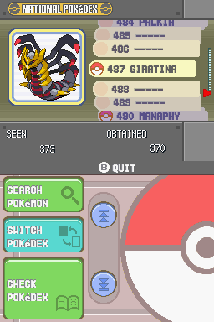
SYSTEM DESCRIPTION
Our project is a recreation of the pokedex. The Pokedex in Pokemon is a database that holds information about each Pokemon.
The user can search for pokemon via various different factors:
ability, name, moves, types, etc.
The user can also check movesets pokemon can learn and the method it can learn it by

Slide 3


IMPLEMENTATION
Languages used: HTML, CSS, JavaScript, and SQL
HTML, CSS used for Front-End portion of the webpage, easy for development
JavaScript and mySQL used for the Back-End portion of the webpage, using mySQL for the database of the Pokedex
JavaScript used due to the dynamics of the webpage, also really easy to connect to HTML, CSS

Slide 4
USE CASE DESCRIPTION
The user can input the name of the pokemon, national number, type of the pokemon, or ability to see the specific pokemon(s) that apply.
It will display data on the pokemon depending on which search method is implemented.
If more than one pokemon applies then the results will display a list of those pokemon.
The user can also click on a pokemon, the results will display the info of those pokemon, their ability, type, and what moves they can learn in the form of a list

Slide 5
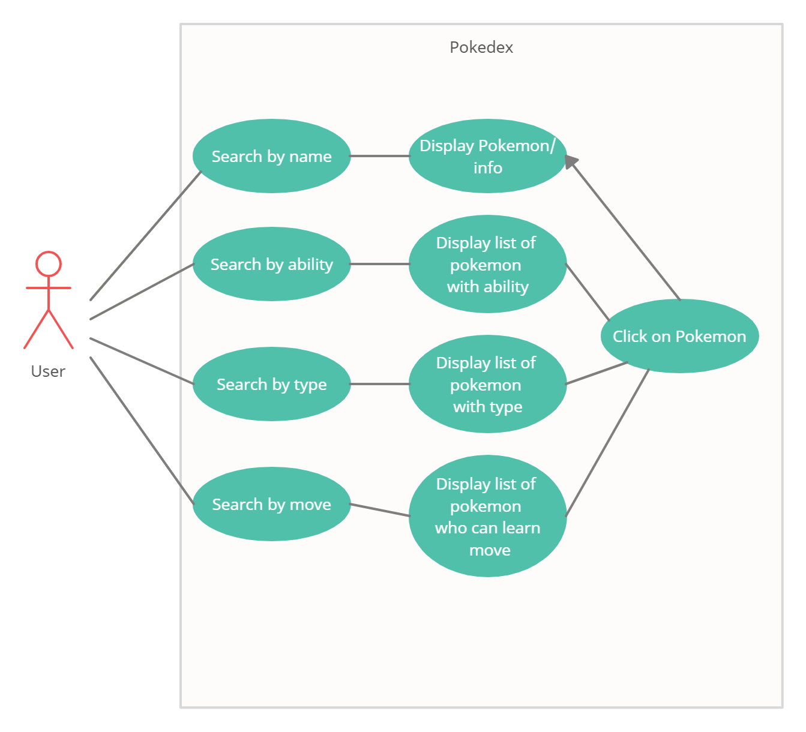
USE CASE DIAGRAM

Slide 6
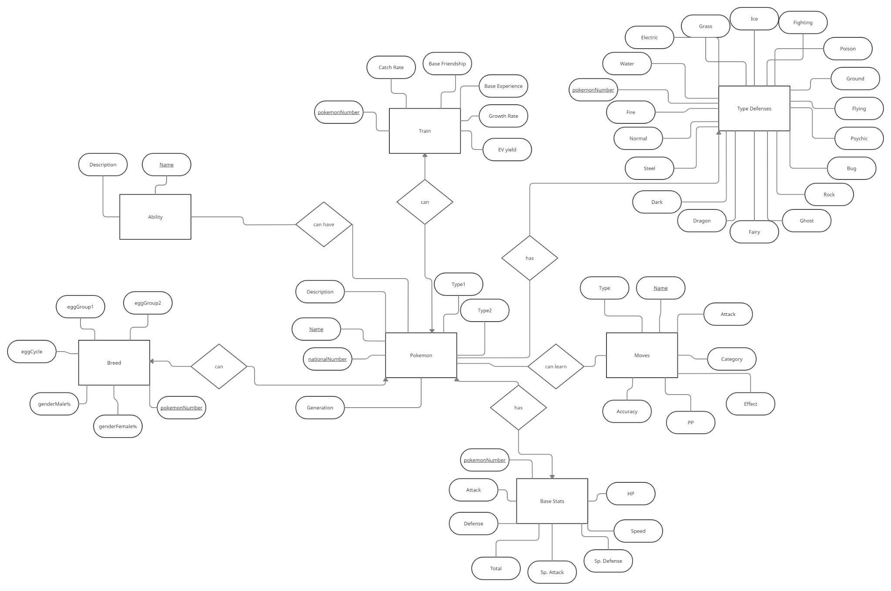
E/R DIAGRAM

Slide 7
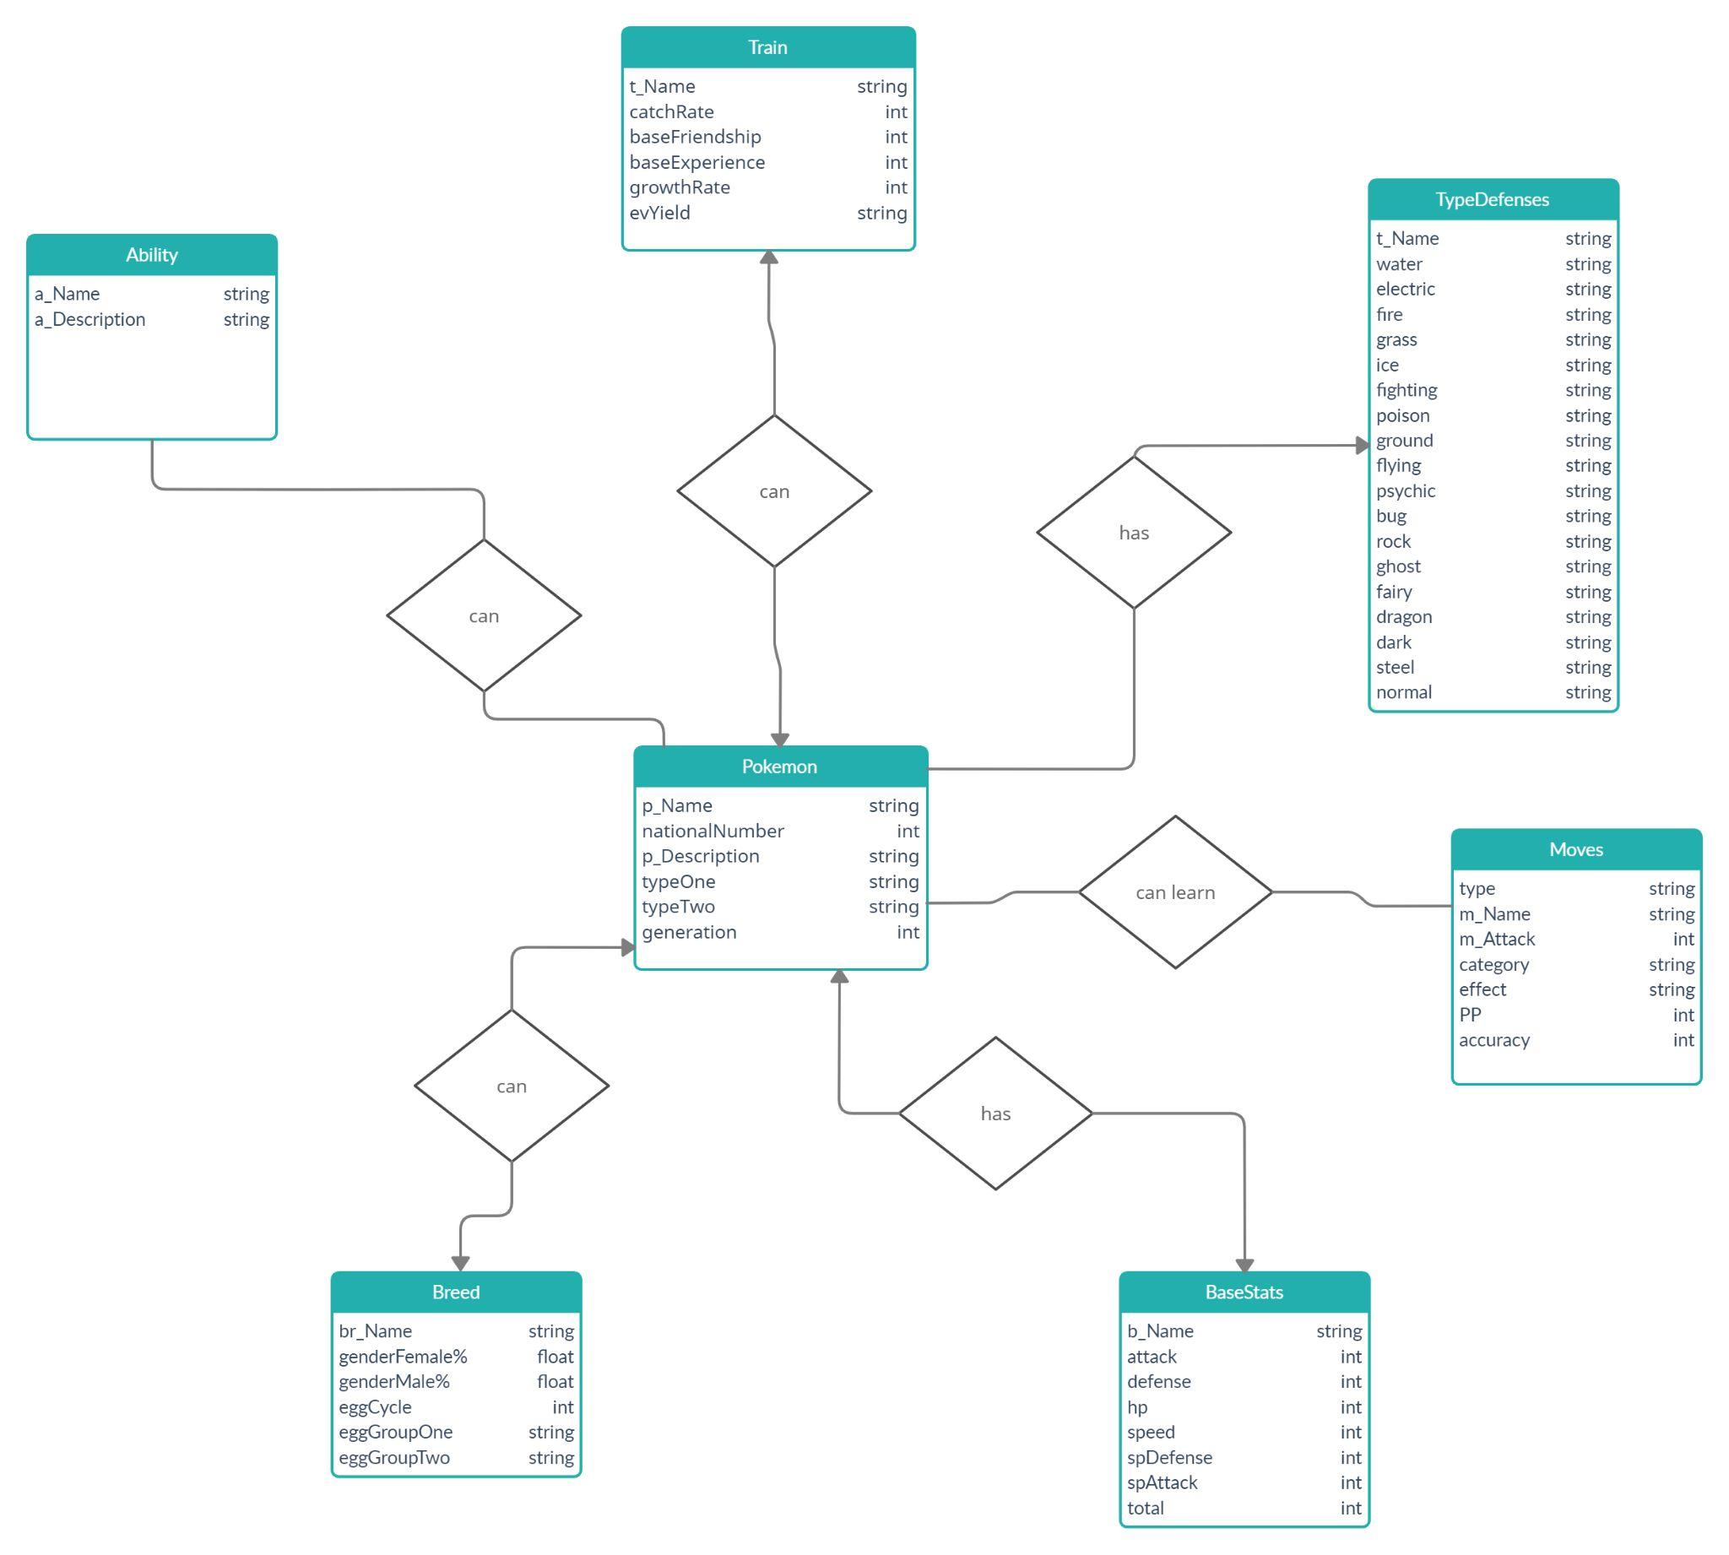
RELATIONAL SCHEMA

Slide 8
Thanks!
Q&A

